Slide 1


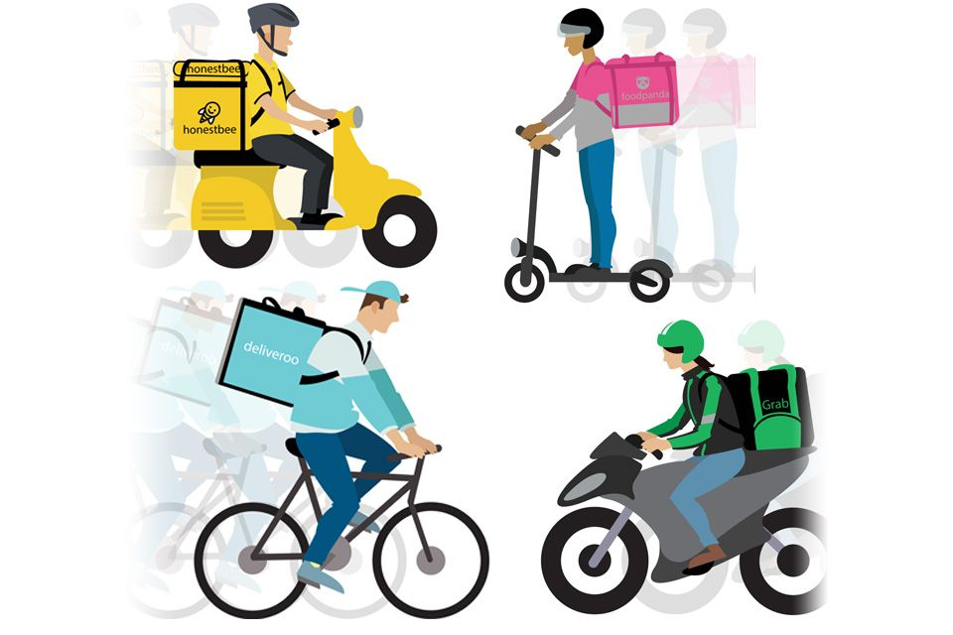
FOOD-IE (Grp 2) Soong Yi Xuan | Lim Hui Zhong | Chia Wei Han

Slide 2
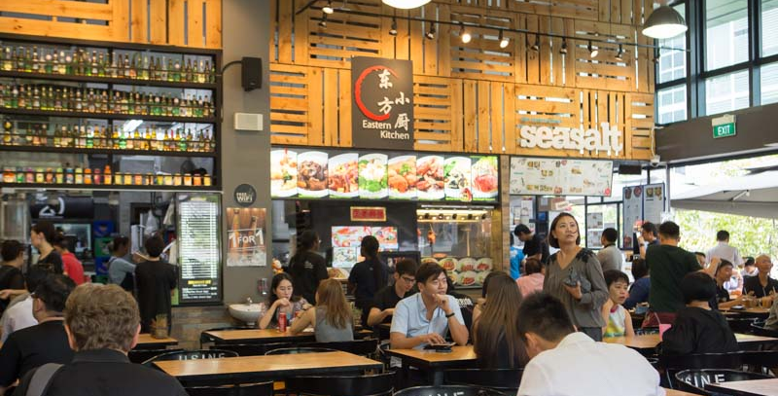
Food Industry
Target mainly retailers and suppliers
Focus on crops sold in the supermarkets
Number of food poisoning cases in Singapore has jumped by 40 per cent on a year-on-year basis from January to October this year (Today Online, 2018)
“Some of the causes could be due to hygiene lapses, infective agents, or food source contamination”
Dr Chia Shi-Lu, chairman of the Government Parliamentary Committee for Health
Notes:
https://www.todayonline.com/singapore/no-definitive-link-between-three-recent-cases-food-poisoning-moh

Slide 3
Processes
Current | Supplier sell ingredients based on trust Difficult to track the food origin Difficult to determine responsibility for purchased crops
Solution | FOOD-IE (Blockchain Supply Chain System)

Slide 4
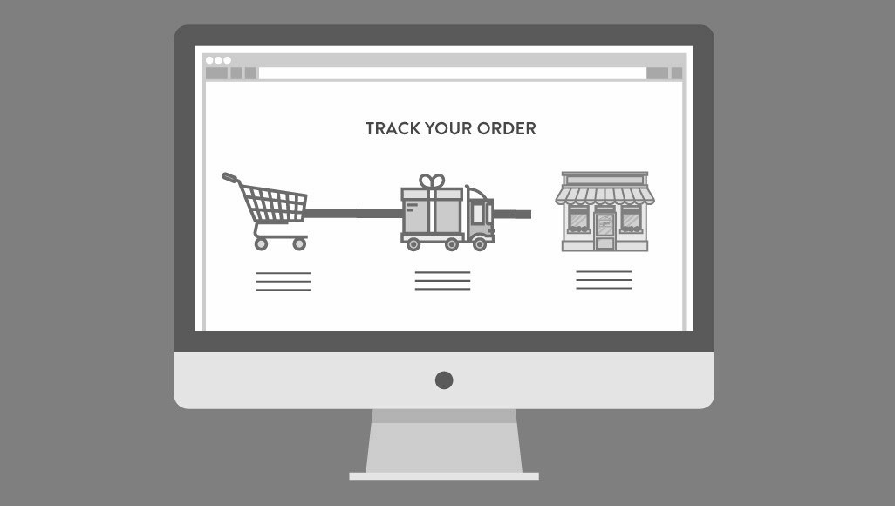
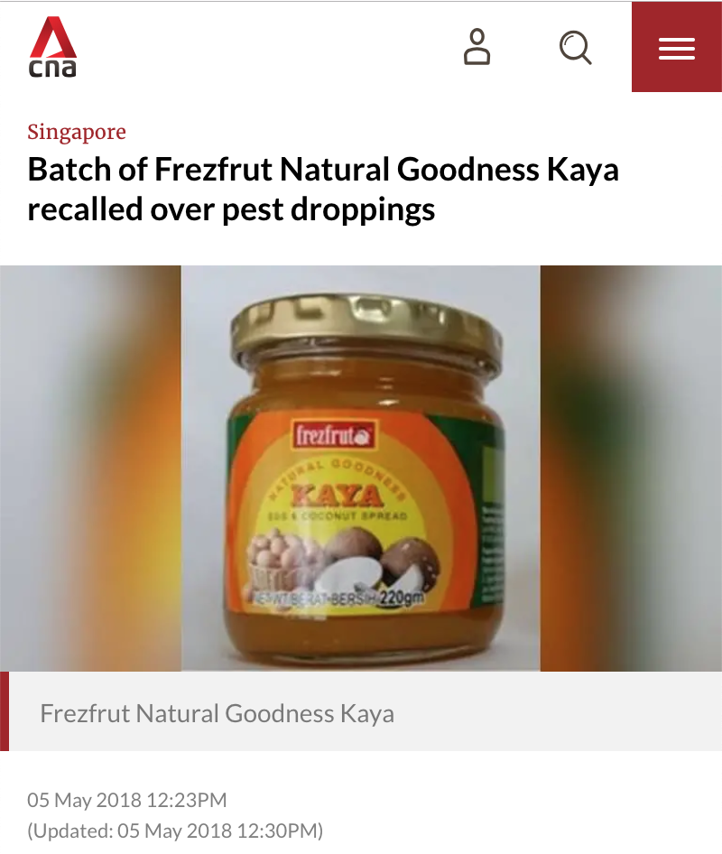
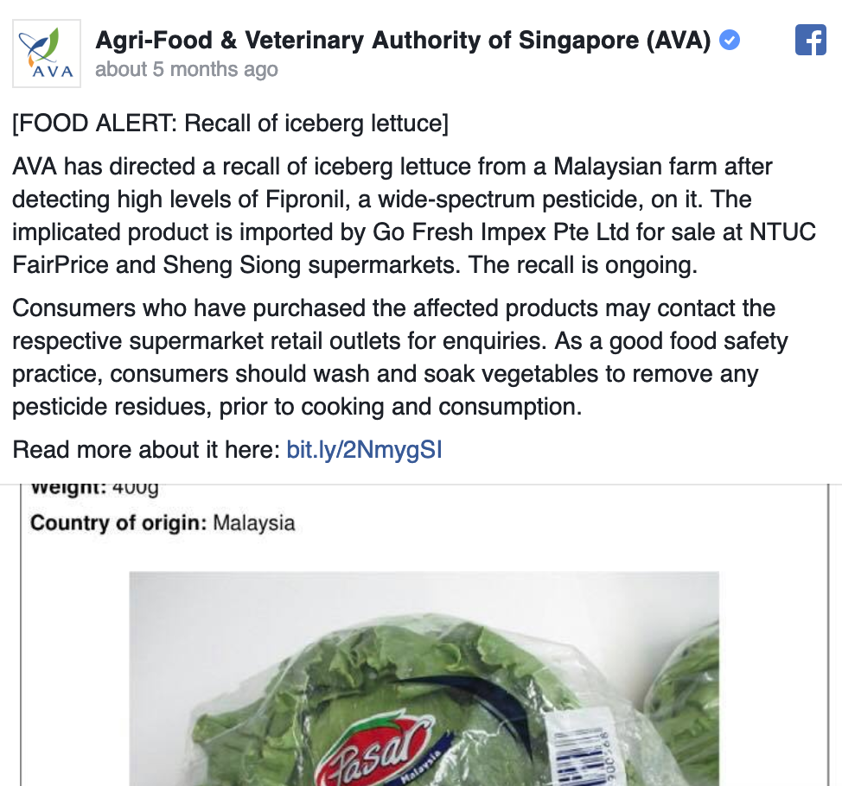
Pain point: Food authenticity
Unable to trace the ingredients origin
Unable to track the food safety throughout the processing
Retailer unable to track the shelf-life
Food wastage due to food with short shelf life
Difficult for agency to trace if a recall is required
Notes:
Another news about the childcare center

Slide 5
How blockchain helps
Ensure food authenticity by checking the source of the ingredients
The food received at store is verified as authentic
Digital record could potentially reveal food safety issues picked up between farm and store
Customer confidence
Mechanism to map the food supply chain to the customer

Slide 6

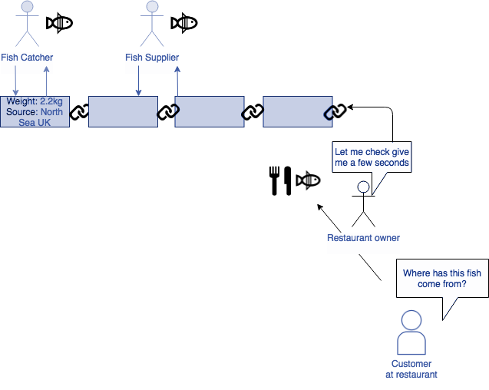
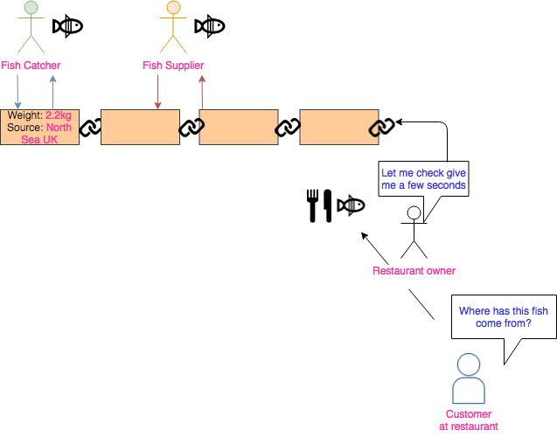
Example Scenario
Farmer
Producer
Distributor
Retailer

Slide 7
Technical
MySql as (Database)
Hyperledger (Blockchain)
Java EE (Back End)
Angular (Front end)

Slide 8
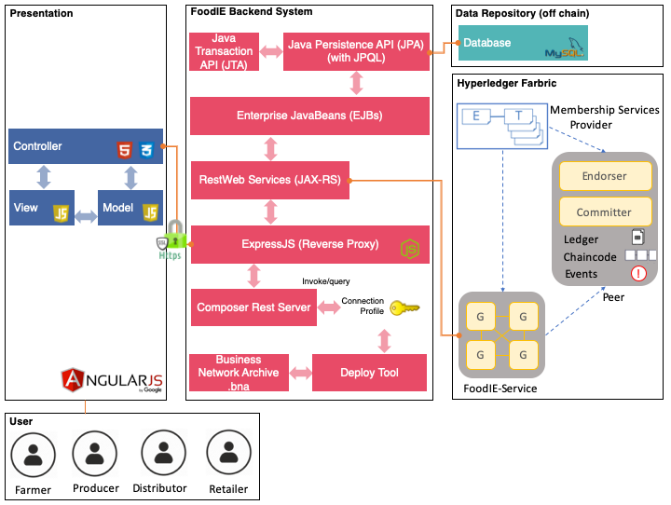
System Flow
1. User Login
2. Presentation (controller) send a Post request to ExpressJS to authenticate the user
4. ExpressJS will redirect to FoodIE backend system to authenticate the user
5. FoodIE backend will generate a JWT token that will allow the user to initiate future API calls
6. User will then call the respective API using the JWT token as the authentication header
- All the API calls will be transmitting in HTTPS protocol

Slide 9
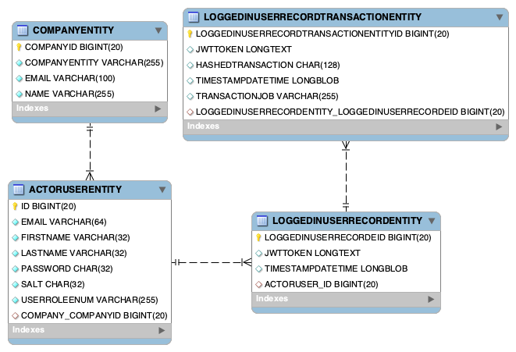

Slide 10
Participants
Producer
o membershipType o category
Farmer
o farmerLicense o farmingActivity
User
o ID o name o address o contactNumber
Retailer
o groupName o managerInCharge o organisation
Distributor
o distributionCenter o employeeId o company

Slide 11
Assets
FinishedGood
o String goodId o PackType packType o DateTime processedDate o DateTime processedTime o DateTime deliveredDate optional o DateTime deliveredTime optional o Status status o Integer quantity o UOM unitOfMeasurements o String hashTransaction --> Crop collectedCrop --> Farmer sourceOwner --> Producer producer --> Distributor distributor optional --> Retailer retailer optional
Crop
o String cropId o String name o UOM unitOfMeasurements o DateTime harvestedDate o DateTime harvestedTime o Integer quantity o COLLECTION collects o String hashTransaction --> Farmer farmer --> Producer producer optional --> FinishedGood finishedGood optional

Slide 12


Transactions
FarmerCreateBatch
o String cropId o String name o Integer quantity o UOM unitOfMeasurements o COLLECTION collects o String hashTransaction --> Farmer farmer --> Producer producer
Farmer
Kok Fah Technology Farm

Slide 13
Transactions
ProducerCreateProcessedBatch
o String goodId o Integer quantity o UOM unitOfMeasurements o PackType packType o String hashTransaction --> Crop crop --> Producer producer --> Distributor distributor --> Retailer retailer
Producer
S. S. KIM ENTERPRISES
ProducerTransferBatch
o String hashTransaction --> Crop crop --> Producer producer

Slide 14
Transactions
DistributorCollectProcessedBatch
--> FinishedGood finishedGood --> Distributor distributor o String hashTransaction
Distributor
Walson Food Distributor
Retailer
NTUC FairPrice
RetailerConfirmCollection
--> FinishedGood finishedGood --> Retailer retailer o String hashTransaction

Slide 15
Identity
Retailer will be required to know who are the users as they can easily track back when the defects happened
Distributor and Producer need to know who will they be getting the food from and who they sent to so that each users would able to forecast the arrival date of food and shorten the processing time
Farmer required to contact Producer company if the vegetables is ready to sell

Slide 16
Privacy (ACL)
Only Farmer and Producer can view Crops
Producer can update the status of Crops
Only Farmer can create Crops
Only Producer can create Finished good
Retailer and Distributor only can view Finished Good and update Status

Slide 17
Question and Answer?
Notes:
No please! :)

Slide 18
AS-IS map
 | FOOD PRODUCTION | FOOD PROCESSING | DISTRIBUTION | PREPARATION
FARMER | Collect crops “How many crops do I have in total?” Doubting - difficult to keep track of multiple crops
PRODUCER |  | Process raw ingredients “How many processed items are created?” Doubting - difficult to keep track of multiple crops | Prepare processed food for distribution “Will my items reach their destination in the same state?” Worrying - if processed food not reach in correct state, customers may not accept order

Slide 19
AS-IS map
DISTRIBUTOR |  |  | Deliver item “Are the items properly packed and in the correct quantity?” Worrying - if items are not accepted, have to send it back to producer
RETAILER |  |  | Receive ingredients “Is my order correct?” Doubting - Need to decline order if quality is not up to par | Sell food “Ensure that the food sell before expiry date” Worrying - if the food that is expired, then is a lost in money

